Slide 1
Use of agents
Dec 5, 2023
Akie Takeuchi
Notes:
Not meant to be complihensive reivew nor tutorial but to give a conclete example of what it does and how to get started to make it a bit tangible and stimulate ideas.

Slide 2
Towards more complex system
Single API call
Sequential API call in a flow predefined by human
Use of other tools (in a flow predefined by human)
AI figure out the best sequence for the query
Multiple AI talk to each other to improve output iteratively
AI improves its output iteratively by monologue
OpenAI native | NA | Tool / Function | Assistant | NA
Langchain | Chain | Tool | Agent | Agent (ReAct)
Semantic-kernel | Kernel | Plugin / Skills | Planner | Planner (stepwise)
Autogen
Notes:
Use of LLM is evolving towards more complex system by combining multile steps of API calls and combination with outside tools.
Each package use different terms for the similar concept that is in the bottom table.
As everyone is probably familiar with first two already, today's focus is 3-5.
Don't worry if it sounds still abstract. I will talk about concrete example of each of these in a second.

Slide 3







Example: AI figure out the best sequence
I would like to return this.
How much is my Nov bill
Today is within 30 days from the delivery. I should accept return.
Dear Ms xxx,
Thank you for being our valued customer …
Certainly. If you send us back the item by Dec 15, you’ll get full refund.
Date of delivery – Nov 16
List of orders in Nov
Today is
– Dec 5
Return policy – within 30 days
Add these numbers
Convert to email format
Notes:
Previously, we define sequence of tasks and hardcoded them with bunch of if /then statements e.g. 1. Figure out intent, 2. Route them to different branch based on intent.
Agent can do this process automatically.
Given a different query, it first figures out, what info it needs to answer it and choose a tool to get required information in right order.
e.g. return case
First, inquire return policy and learns it needs # of days between delivery and today. So it calls order DB and calender to get these info. Based on policy and two dates, it answer the question.
e.g. billing inquiry email case
First it needs to reteive list of orders and add up all amount with calculator. Finally, it need to write in fomal email format.
Without defining each use case manually (which can be quite numerous and tedious), we can build a multifunctional bot.

Slide 4
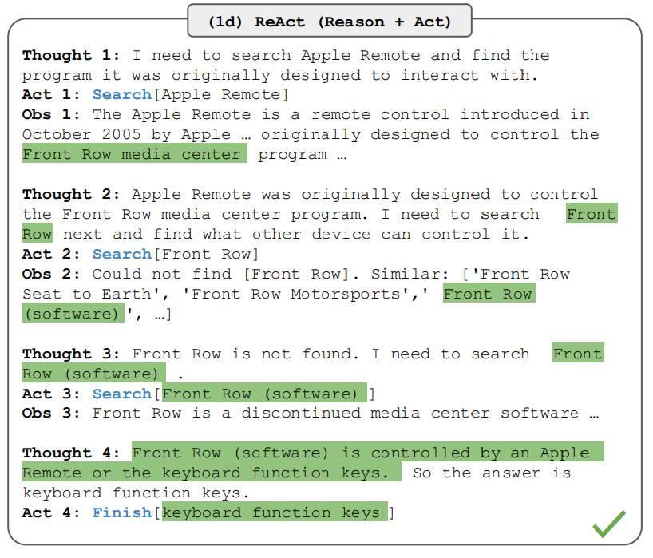
Example: AI improves its output iteratively
Aside from the Apple Remote, what other devices can control the program Apple Remote was originally designed to interact with?
Image Source: Yao et al., 2022
Notes:
This is a example streight from the paper.
It starts with user query that requires two separate piece of information. (1) what is the program in question (2) what device can control the program.
Agent act in 3 steps and repeat the set until it finds the answer.
Steps are
(1) Figure out what info it needs (reason)
(2) Search / retreive info (act)
(3) Understand the answer to (1) (observe)
Based on the finding of these 3 steps, it goes back to (1) and thinks what additional info it needs.

Slide 5



Example: Multiple AI talk to each other
Python code to do xxx, input: xxx, output:xxx
Human user
User proxy with code execution tool
Assistant role
Import xxx
Def my_func(x,y):
xxx
It produce this error
Value error …
I am sorry, here’s an improved code
…
It run successfully. Mission completed
Fact checker /Quote finder
Compliance checker
Automated bot tester
Repo: https://github.com/microsoft/autogen
Notes:
This is code generation example.
Think about yourself using GPT to write code, orange part is what we do but it's actually a bit tedious. We can automate it with agent.
Here we have assistant who produce code (normal one).
We also have one more AI that act like user. It runs the given code and feed the result into assistant until the code runs successfully and produce desired result.
This is a bit GAN like setting and we can probably think of other similar use of generator and checker.
We can may be automate a part of bot testing. We all have done tedious chat with bot typing similar but slightly different (thus difficult to fully automate) answer for testing.

Slide 6
Demo
EC customer assistant bot with Open AI, Semantic-kernel, langchain

Slide 7
Difference?
OpenAI assistant:
Doesn’t excecute function. (It wait for other program to supply the result of the function call.),
Need to parse object API returns with complicated structure
Not much control of behavior in detail
no access control.
Semantic-kernel:
Treats prompts for sepecific task in a same way as functions (-> agent/planner can dynamically choose right prompt )
No sandbox code excecution. (but it does execute function call)
light weight = limited in # of connectors (to DBs, language models, file types etc.)
Looks a bit more organized (IMO)
Notes:
We have just used 3 different packages to do the same task. How do they differ? This is by no means complihensive but just listed a few important differences I found.
Sk has concept called skills and it includes both prompt instruction to LLM and other function calls. Prompts are just function to take string in and output string that can be used as building block to the final anwer and planner can dynamically combine them as a part of flow. Example could be summerize conversation into specific format, write in email format, translate into another language etc.

Slide 8
Benefits & Concerns
Benefits
Flexibility of behavior (v.s. hardcoded if thens)
Reusable building blocks
Quality control
Accuracy
Concerns
Cost
Excecution time
Stability / controlability
Notes:
To summarise, what is the benefit of agent and what are the catches?

